Slide 1

CONFLUENCE AND JIRA
GUIDE FOR USER AFTER MIGRATION

Slide 2




Introduction
Kering Technologies is changing and evolving. To support this growth, we must repatriate the collaborative tools JIRA Software & Confluence on servers.
For definite advantages:
A gain in tool performance
Simplified access to tools
New opportunities offered as a result of this migration
A support team is at your disposal if necessary on these two tools.
Feel free to contact them at: keringtechcollaborativetool@kering.com
This guide is there to answer your questions and give you good practices with two tools.
Guide for User – Confluence & Jira Software

Slide 3

Information about these new JIRA Software and Confluence ?
Informations
Quick informations :
New : URL of JIRA and Confluence have changed, see below
All data have been transferred on the new JIRA and Confluence
The old plateform will be keep for one month with read right only.
New : Two ways to authentificate on JIRA and Confluence
Guide for User – Confluence & Jira Software

Slide 4
URL of JIRA Software and Confluence ?
New URL for both tools
jirabuild.keringapps.com
Guide for User – Confluence & Jira Software
confluence.keringapps.com
Tips :
Put these two addresses in your browser favorites ☺ !
Use Chrome / Firefox / Safari / Edge on Confluence and JIRA. Avoid Internet Explorer.

Slide 5
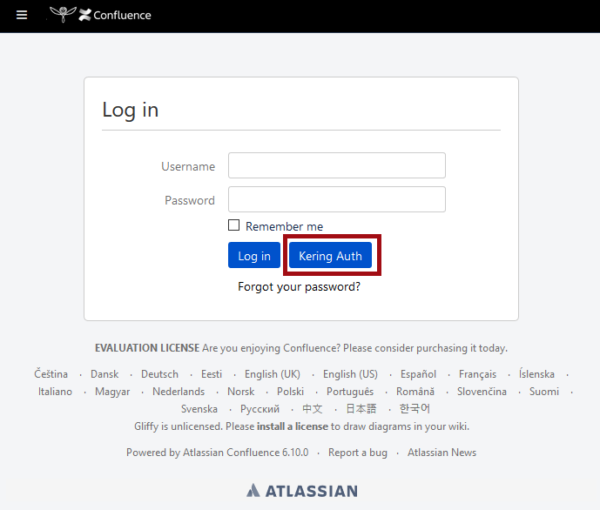
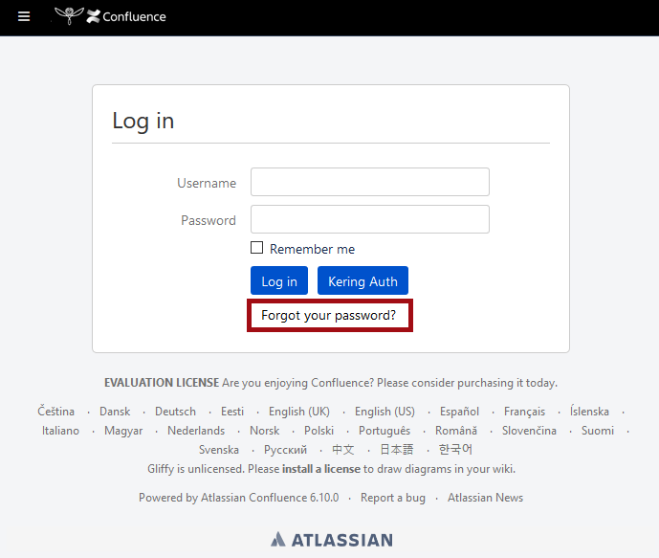
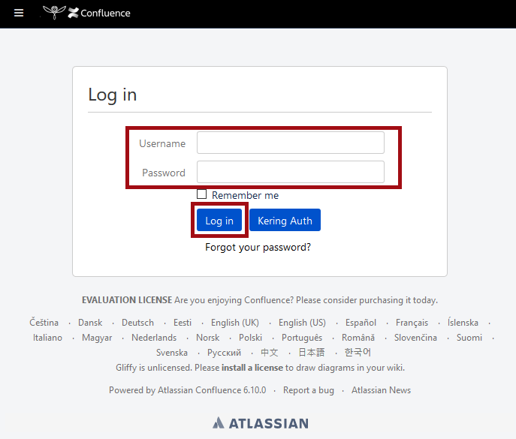
How to connect on the new Jira Software and Confluence ?
Two way to connect for both tools
People who have an Kering email
People who don’t have an Kering email
You can use the "Kering Auth" button to connect with your Windows / Classic Email account, you will no longer have to have a specific password for JIRA & Confluence.
You need to reset your password with the link “Forgot your password” and connect after with the classic form.
Guide for User – Confluence & Jira Software

Slide 6
Good practices on Jira Software and Confluence ?
Good practices to start on these tools
Put your First Name with the first letter in capital letter and Last Name on uppercase in JIRA
Choose your most beautiful picture of yourself and put it on Confluence AND JIRA
Your old profile image is no longer present on the tools.
Fill in your profile information, this will allow your colleagues to know more about you !
Don’t use the old JIRA and Confluence.
Where I can do that :
Your first and last name : https://jirabuild.keringapps.com/secure/ViewProfile.jspa
Your photo
  On Jira : https://jirabuild.keringapps.com/secure/ViewProfile.jspa
  On Confluence : https://confluence.keringapps.com/users/profile/editmyprofilepicture.action
Your info
  On Confluence : https://confluence.keringapps.com/users/editmyprofile.action
Guide for User – Confluence & Jira Software

Slide 7
Support on Jira Software and Confluence ?
Support on JIRA and Confluence
Any questions / remarks / feedback : don’t hesitate to contact us !
keringtechcollaborativetool@kering.com
Guide for User – Confluence & Jira Software

